Slide 1
Method OVERLOADING AND OVERRIDING

Slide 2


Slide 3
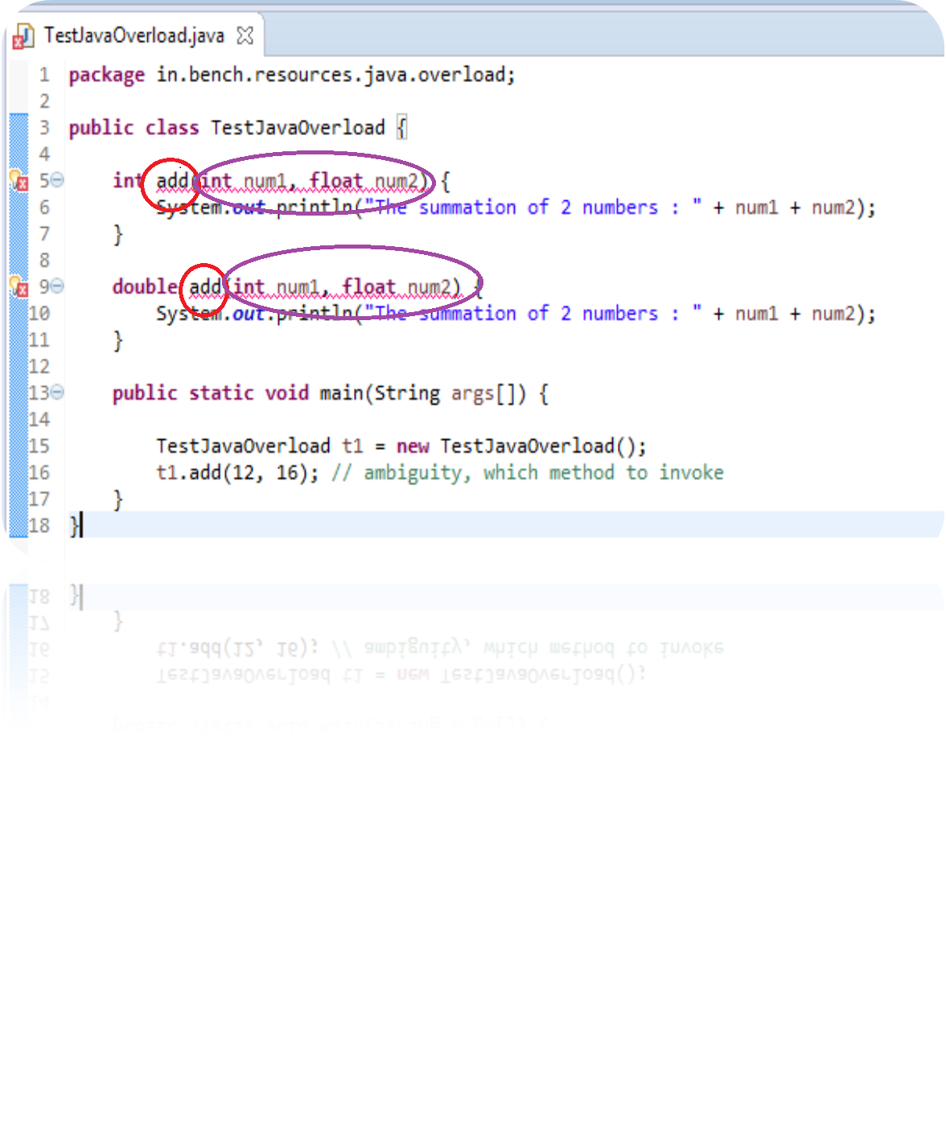

Slide 4
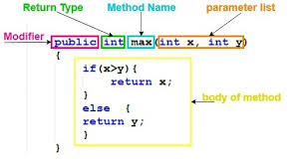
METHOD

Slide 5
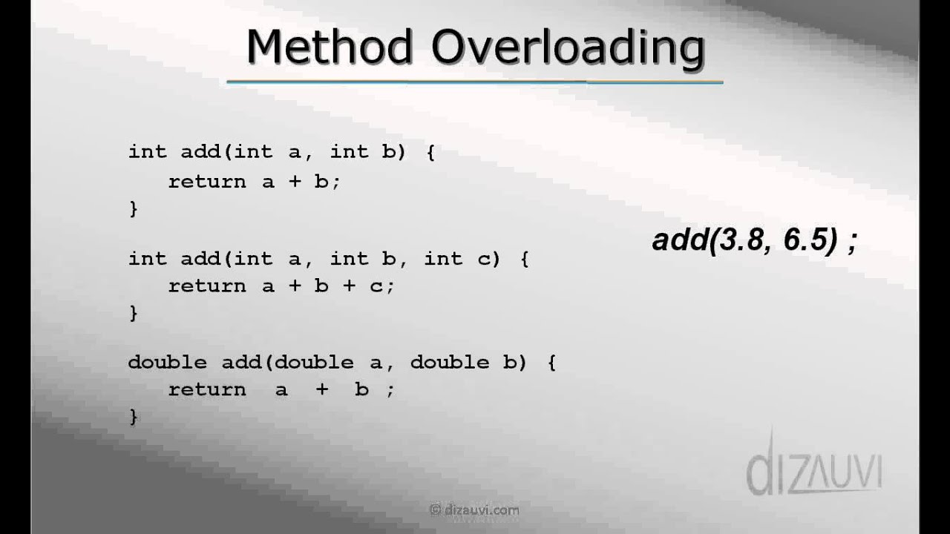
Method overloading
The concept of method overloading enables us to declare two or more methods with same name but with different behavior.

Slide 6
How to overload a method in java
Generally, any overloaded method in java has different set of arguments to perform something based on different number of inputs.
To overload a java method, just change its signature.
To change signature, either change the number of arguments or change the type of argument or their order.

